Slide 1
Entity Relationship Diagrams
2.2

Slide 2

ERDs: The “Logical” Model
Building on the foundation of your CDM
Entity Relationship Diagrams are a more formal evolution of your Conceptual Data Model
Conceptual → Logical → Physical
Conceptual is for brainstorming
Logical is for formalizing
Physical is for implementation (depends on the RDBMS being used)

Slide 3

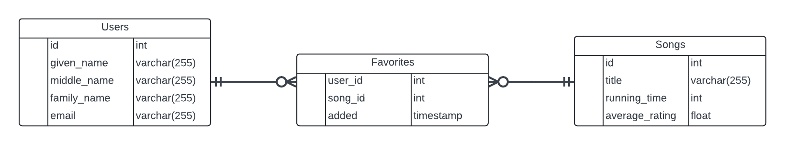
“Boxes” and “Arrows”
“Entities” are now “Tables”
Begin to list attributes and data types
“Arrows” are replaced with Crow’s Foot Notation
Descriptors are not needed

Slide 4
Table Naming Conventions
Naming conventions are controversial and HIGHLY dependent on an organization
Whenever possible, follow existing conventions
Consider the use of the table names in queries and software development:
In SQL:
“SELECT * FROM users”
“SELECT first_name FROM users”
In development:
${user.first_name}
${users.first_name}
General rule(s) of thumb:
Table names are plural
A variable referencing a single instance (row) of the table is singular

Slide 5
Field Naming Conventions
Very VERY controversial!
Naming conventions are highly dependent on an organization
Whenever possible, follow existing conventions
Field names are singular (atomicity)
Underscores are preferred for readability and accessibility
PascalCase
camelCase
🌟 underscore_style 🌟
If a surrogate key is used as a primary key, just use the field name id

Slide 6
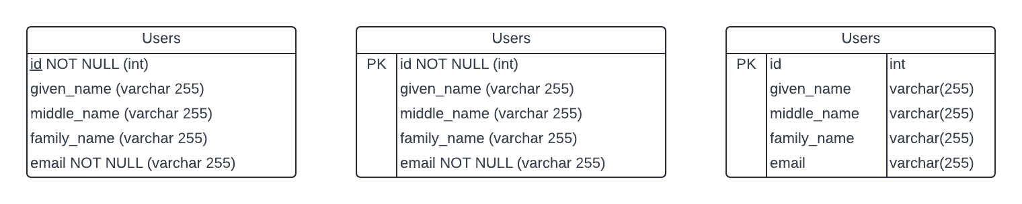
Table Shapes in an ERD
Plan for future expansion
Tables in an ERD can have 1, 2, or 3 columns
Each field in the table will have 3 pieces of information
Key status (Primary Key, Foreign Key, etc.) (not needed this week)
Name (underscored for clarity)
Data type
Supplemental information (not needed this week)
Nullability

Slide 7

Crows Foot Notation
There is LOTS of nuance here, but focus on the 3 relationship types we’ve discussed:
1:1
“One to one”
“Exactly one to exactly one”
1:*
“One to many”
“One to a min. of one but could be more”
“One to zero or many”
*:*
”Many to many”
“Zero or many to one or many”

Slide 8
Focus on the Basics of the Relationships
For your first ERD, focus on the 3 basic relationship types

Slide 9
Keys in Relational Databases

Slide 10

Keys Uniquely Identify Records
Key is a unique identifier for a specific record
What good is data if we can’t find it and can’t associate it with related records?
A key is an attribute or attributes (either existing or new)

Slide 11
Candidate Keys
Any attribute (or combination) is a candidate to be a key
Considerations for candidate keys:
Uniqueness
Minimality (use as few columns/attributes as possible)
Cannot be NULL
There might be multiple candidate keys
Must choose the “primary” key from candidates
Employees
name | VARCHAR(255)
social_security_number | INT
birthdate | DATE

Slide 12
Primary Keys
Each database record should have ONE AND ONLY ONE* primary key that uniquely identifies that record
Primary key cannot be NULL
Can create a composite (or “combo”) key out of multiple fields
When uniqueness or non-nullability cannot be guaranteed, create a surrogate key
Employees
name | VARCHAR(255)
social_security_number | INT
birthdate | DATE
email | VARCHAR(100)
id | INT

Slide 13
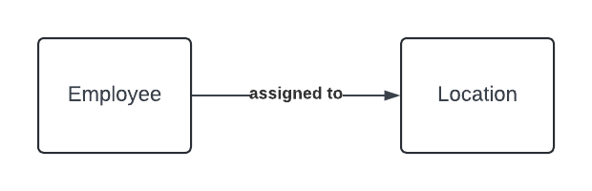
Foreign Keys
Making connections
When a primary key is stored as a reference to its original record, it is called a foreign key
Example: An employee works at one location
Employees
id | INT
given_name | VARCHAR(100)
family_name | VARCHAR(100)
social_security_number | INT
birthdate | DATE
email | VARCHAR(100)
location_id | INT
Locations
id | INT
street_address_1 | VARCHAR(255)
street_address_2 | VARCHAR(255)
…

Slide 14
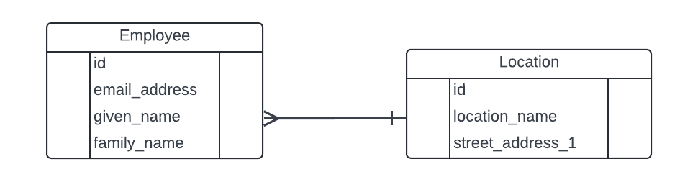
Notation Example
An employee works at one location

Slide 15
Reading the Notation
An employee works at one location
Employee works at one location
Location has many employees

Slide 16
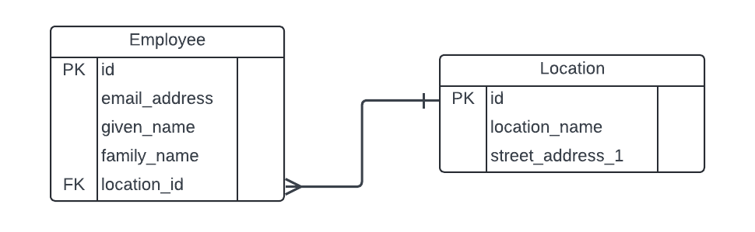
Foreign Key Placement
An employee works at one location
”The crow knows
the foreign key.”

Slide 17
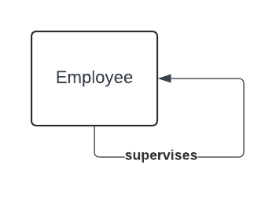
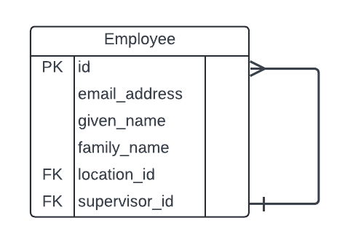
Foreign Keys
Making connections
It is possible to have a foreign key relationship within the same table
Employees
id | INT
given_name | VARCHAR(100)
family_name | VARCHAR(100)
social_security_number | INT
birthdate | DATE
email | VARCHAR(100)
supervisor_id | INT

